Slide 1
Pain and Symptom Management for the APRN
Dr. Cinnamon B. Tucker, DNP, APRN, FNP, ACHPN

Slide 2
Morphine, Dilaudid, and Methadone -oh my !!!
Selecting the most appropriate opioid(s) for your patient should NOT be difficult.

Slide 3
Objectives
-The nurse practitioner will feel more confident in treating pain and other symptoms common in hospice and palliative care patients
-The NP will be able to accurately identify different types of pain.
-Selecting opioids and adjuvants for pain-including Methadone
-Managing pain with substance use disorder
-Dyspnea, insomnia, anxiety, depression, cachexia, and CONSTIPATION
-

Slide 4
Recommendations for further learning -HPNA Certification -AAHPM -ELNEC

Slide 5
Case Study #1
General: mild distress due to pain, answers questions appropriately
HEENT: NCAT, non-icteric sclera, EOMI, PERRL, MMM
Neck: no appreciable JVD, neck supple, trachea midline
CV: RRR, normal S1 S2, no murmurs, rubs, or gallops appreciated
Lungs: no wheezes, crackles, rhonchi, or stridor appreciated; diminished BS bilateral lower lobes
Abdomen: soft, suprapubic ttp, nd, +BS, no masses or organomegaly, no rebound/guarding; right sided CVA ttp
Ext: 2+ radial and DP pulses bilaterally, warm, pitting edema b/l LE to knees
Skin: no c/c/e, no rashes noted; HD catheter in place in pt's right chest, no erythema, non-tender at site
Neuro: A&Ox3, no gross focal deficits
Psych: appropriate mood and affect, good judgement
What is the Palliative Plan of Action ????
Mrs. FJ is a 50 y/o50 y.o. year old female with a PMHx of ESRD, MSSA bacteremia with incomplete treatment, xanthogranulomatous pyelonephritis with hx nephrostomy tubes, HTN, HLD who presented with recurrence/continuation of previous pyelonephritis and volume overload after missing dialysis. Speaks only Spanish.
OME: 380 (Dilaudid IV-19mg)
Vitals: 176/107, HR 107, sats 99% RA, 140#, Pain 10/10
GFR: 10, BUN: 45, Creatinine 6.58
Orders: IV Dilaudid 2mg IV Q 4 scheduled and 1mg IV Q 6 hours prn

Slide 6
Palliative Medicine Consultant Report
Palliative medicine introduced to patient via translator. Comprehensive pain assessment performed. Patient rates mixed type flank pain 10/10 and on IV Dilaudid scheduled and prn-19mg given over last 24 hours. Also with intractable nausea, which patient getting Zofran frequently. Upon exam, patient AAOX4, conversive. Pain is better each day. Points to flank area with anasarca and BLE +3 edema. Not eating well due to pain and nausea. Patient seems to have limited insight into health mgmt. Will further discuss and scheduled patient with palliative outpt provider for chronic pain with life limiting illness. Patient's last bm today, minimal po intake, did take some sips of water and jello without nausea. Expressed concern to patient about leaving hospital prior to discharge; she agreed to remain inpt until safe discharge and follow up arranged.
PLAN/SUMMARY OF RECS:
-Ensure clear or renal oral supplement
-will schedule for outpt palliative medicine clinic
-Flexeril 5mg PO TID
-Fentanyl 12.5mcg patch Q 72 hours
-Oxycodone 30mg PO Q 4 hours prn
-Stop scheduled Dilaudid; start Dilaudid 1.5mg IV Q 4 hours prn breakthrough pain
-Dulcolax 5mg PO every other day

Slide 7
What is Pain
“An unpleasant sensory and emotional experience associated with, or resembling that associated with, actual or potential tissue damage” IASP
Pain is always a personal experience that is influenced to varying degrees by biological, psychological, and social factors.
Pain and nociception are different phenomena. Pain cannot be inferred solely from activity in sensory neurons.
Through their life experiences, individuals learn the concept of pain.
A person’s report of an experience as pain should be respected.
Although pain usually serves an adaptive role, it may have adverse effects on function and social and psychological well-being.
Verbal description is only one of several behaviors to express pain; inability to communicate does not negate the possibility that a human or a nonhuman animal experiences pain.

Slide 8
Types of Pain
NOCICEPTIVE NEUROPATHIC
Pain that arises from actual or threatened damage to non-neural tissue
Originating from soft tissues, bones, organs
Somatic- localized, intermittent, or constant, aching, gnawing, throbbing, or cramping.
Visceral- as deep, squeezing, or colicky
Can be acute or chronic (>3 months)
Can have mixed type-includes Nociceptive and Neuropathic
Example: metastatic bone pain, liver mass, pancreatitis
Pain that comes from injury or disease to the to the central nervous system Originating from nerves and blood vessels
Can be from the central nervous system (CNS)
Can be from the peripheral nervous system (PNS); examples
Can be acute or chronic (>3months)
Can have mixed type-includes Nociceptive and Neuropathic
Examples: Spinal cord compression, Shingles, post mastectomy/thoracotomy pain

Slide 9
Do you feel like this???

Slide 10
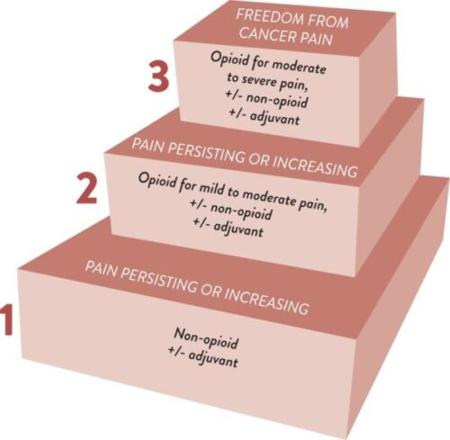
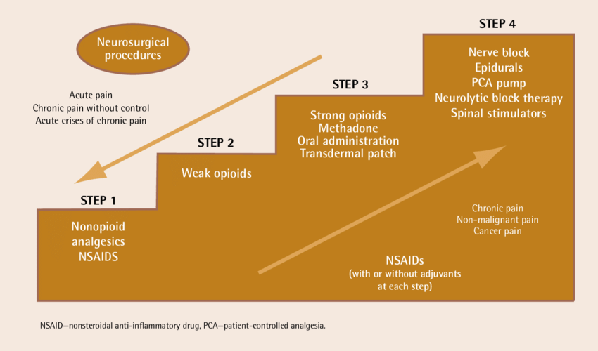
The WHO Pain Ladder
1986-THEN 1996-NOW-ish
Figure 1. The WHO three-step analgesic ladder. Source: WHO guidelines for the pharmacological and radiotherapeutic management of cancer pain in adults and adolescents. Geneva: World Health Organization; 2018. PubMed. CC-BY-NC-SA-3.0 IGO.

Slide 11
Comparing Major Opioids
MORPHINE Moderate-Severe (acute/chronic) | FENTANYL Moderate-Severe | DILAUDID Moderate-Severe | OXYCODONE Moderate-Severe | METHADONE Moderate-Severe (persisting)
PO 1:1 IV 1:3 Duration: 3-5 hrs | IV 1:50-100 TD 1:2 Duration: 4-6IV 72hrs-TD | PO 1:4 IV 1:20 Duration: 3-6 | PO 1:1.4 Duration: 4-6 | 4:1<90 8:1<90-300 12:1 >300 Duration: 4-12
-$$ IR (po, liq, supp) SR | $$$ PCA Patch, Lozenge | $$$ PCA IR, SR | $$ SR-$$$ IR-tabs, liquid | $ Tabs, Liquid
PO: 7.5-15mg Q4 SR: 15-200mg Q 8-12 IV: 2-4mg Q 4 prn PCA: 0.5-3mg/hr for BTP, 10% of the 24h infusion dose q1h prn | Starting dose: 12-25mcg/hr PCA:240–480 mcg/24h -for BTP, 10% of the 24h infusion dose q1h prn | -Oral: 1–4 mg Q 4 prn - SC/IV injection: 0.3–0.7 mg Q 3-4 prn -SC/IV PCA: 0.1–0.2 mg/h. | 2.5-5mg PO Q 4 prn SR: 10 -80mg | >400 OME 2.5 mg (1–2 mg in older persons) PO q8h.
Renal Failure/Liver failure | Liver Failure Low BMI-<17/18 Short term use Head Injury | Short term use Head Injury Renal failure GFR <10 | Renal Failure/Liver failure | Short term use Head Injury Prolonged QT Liver Impairment
n/V/c, rash, flushing , hives Hallucination | n/v/c, dry mouth, biliary spasms, taste, diaphoresis | n/V/c, rash, flushing , hives Hallucinations, dry mouth, biliary spasms, taste, | n/v/c, dry mouth | Depersonalization, HTN, agitation, msk weakness

Slide 12
Adjuvants
Analgesics
-Acetaminophen
650mg-1000mg
PO Q 6-8 scheduled
Watch liver and prn usage
-NSAIDS
Ibuprofen, Celebrex, Toradol IV>PO
400-800mg PO Q 8
Watch renal fxn and prn usage, GI issues
SSRI/SNRI
Venlafaxine(Effexor)
37.7-150mg QAM
-hot flashes, sweating
Duloxetine (Cymbalta)
30mg -120mg QPM
-causes sweating
SE: HTN, insomnia, drowsiness, dizziness, constipation, dry mouth
SSRI: Paxil, Prozac
boost effect of TCA
Tricyclic Antidepressants
-Amitriptyline (Elavil)
10-150mg PO QHS
-Nortriptyline (Pamelor)
10-150mg QHS
SE: blurred vision, dry mouth, SLEEP, WEIGHT GAIN, constipation, hypotension
LOW & SLOW
Drug Interactions
Anticonvulsants
-Gabapentin
100-1800mg/day
-Carbamazepine
200-400mg/day
*Nerve pain r/t chemo
SE: abuse, somnolence, thrombocytopenia,
Others
Msk Relaxers
-Zyprexa***
-Psychotherapy
-Medical Marijuana
-PT/OT
-Acupuncture
-Complementary Medicine
-Lidocaine, Capsaicin
-Nerve Blocks

Slide 13
Individualized Medication Selection for refractory pain (Maybe some of you work in Mayberry-I don't so, here we go!!)
DX
Allergies (true)
Renal and Hepatic fxn
Previous experience
Daily OME
USE of adjuvants
UDS
Social Situation
Cognition/adherence
Long acting??
REGIMEN
F/u??
MED MISTRUST

Slide 14
Case Study #2
Physical Exam
Appearance: She is ill-appearing.
HENT: Head: Normocephalic and atraumatic.
Mouth/Throat: Comments: Oropharynx is dry, no erythema or open lesions noted; chapped lips No scleral icterus.
Cardiovascular: Regular rhythm. Tachycardia present. Normal heart sounds.
Pulmonary: Pulmonary effort is normal. Normal breath sounds.
Abdominal: Abdomen is flat. Bowel sounds are normal. Abdomen is soft. There is no mass.
Skin:: Skin is warm and dry.
Neurological: General: No focal deficit present. Mental Status: She is alert.
What’s the Palliative Plan???
Pt AD is a 64 y.o. AA woman with PMH of Pancreatic Adenocarcinoma currently on chemotherapy, Crohn's disease, and prior DVT who presented with worsening abdominal pain for 2 weeks.
Triage: BP: 111/72 | Pulse: (!) 113 | Temp: 100 °F (37.8 °C) | Resp: 22 | Height: 160 cm (5' 3") | Weight - Scale: 45.4 kg (100 lb) | BMI (Calculated): 17.8 | SpO2: 100 %
ED, 1 L LR, Vanc/ Cefe, and Dilaudid 2 mg +Oxycodone 10 mg PO Q8H for pain
GFR>105, Creatine 1.4, WBC 0.7, H/H 7.5/23

Slide 15
Palliative Consultant Report
Patient known to palliative medicine service, last visit 2/6, for which Zyprexa was increased for appetite/sleep and nausea. Unclear if patient was consistently using. Pain regimen was stable using Bentyl and Oxycodone 10 for pain mgmt. Follow up appt scheduled for 4/30.
Patient seen at bedside with cousin; very concerned about future Onc plan and poor functional status. Spoke with primary Oncology, will talk to patient tomorrow am and family if allowed. Right now, if patient is to recover, has good cure rate. However, due to counts, poor PO intake and worsening functional status, treatment on hold.
Patient with conversive with whisper, minimally engaged, improvement with IV meds. Will continue to follow. Able to sip water and Ensure-completed 1.5 cartons today. + bm daily, soft.
PLAN/SUMMARY OF RECS:
-Zyprex 5mg IV Q 12 for nausea and pain
-Continue IVF until PO intake improves
-12.5mcg Fentanyl Patch
-Continue IV Dilaudid Q 4 as ordered and Oxycodone solution as ordered
-will convert to PO when able to swallow without pain

Slide 16
References
https://www.iasp-pain.org/publications/iasp-news/iasp-announces-revised-definition-of-pain/. Retrieved 3/12/2024
Carver AC, Foley KM. Types of Pain. In: Kufe DW, Pollock RE, Weichselbaum RR, et al., editors. Holland-Frei Cancer Medicine. 6th edition. Hamilton (ON): BC Decker; 2003. Available from: https://www.ncbi.nlm.nih.gov/books/NBK12991/
Yang, J., Bauer, B. A., Wahner-Roedler, D. L., Chon, T. Y., & Xiao, L. (2020). The Modified WHO Analgesic Ladder: Is It Appropriate for Chronic Non-Cancer Pain?. Journal of pain research, 13, 411–417. https://doi.org/10.2147/JPR.S244173
https://pinkbook.dfci.org/assets/docs/pinkBook.pdf. Kematick, B.S., Suliman I., Hood, A.H., et al. (2020).
WHO guidelines for the pharmacological and radiotherapeutic management of cancer pain in adults and adolescents. 2018. https://iris.who.int/bitstream/handle/10665/279700/9789241550390-eng.pdf?ua=1
Antidepressants: Another weapon against chronic pain. Mayo Clinic. 2019. https://www.mayoclinic.org/pain-medications/art-20045647#:~:text=Tricyclic%20antidepressants%20are%20the%20most,Nortriptyline%20(Pamelor).

Slide 17
Thank You
Cinnamon Tucker
504.702.4408
Cinnamon.Tucker@lcmchealth.com

